Slide 1

SFWRENG 4G06 | Final Demonstration
SFWRENG 4G06 | Final Presentation
Group 3 | Tiny Coders
Notes:
Leon Hi, we are Tiny Coders and welcome to the final presentation for our project: Sayyara

Slide 2
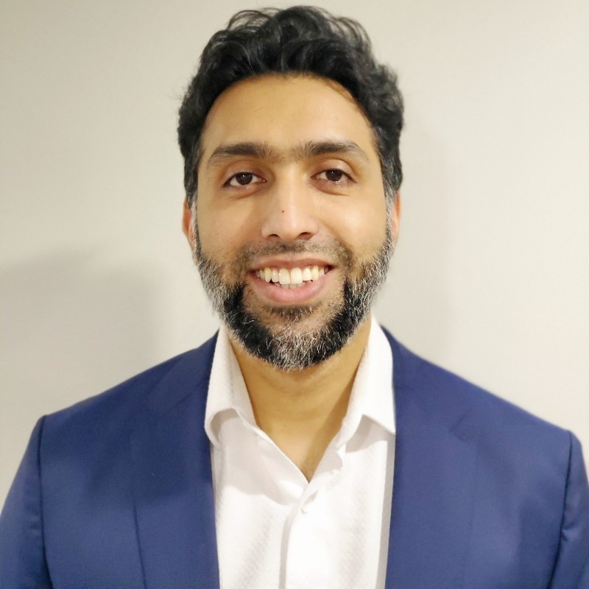






Meet the Team
Nabeel Ibrahim Project Supervisor
Arkin Modi Project Lead & Developer
Joy Xiao Developer
Leon So Developer
Tim Choy Developer
Notes:
Leon The team behind Sayyara is Arkin, Joy, Tim, and myself, Leon. This project was completed under the supervision of Nabeel.

Slide 3

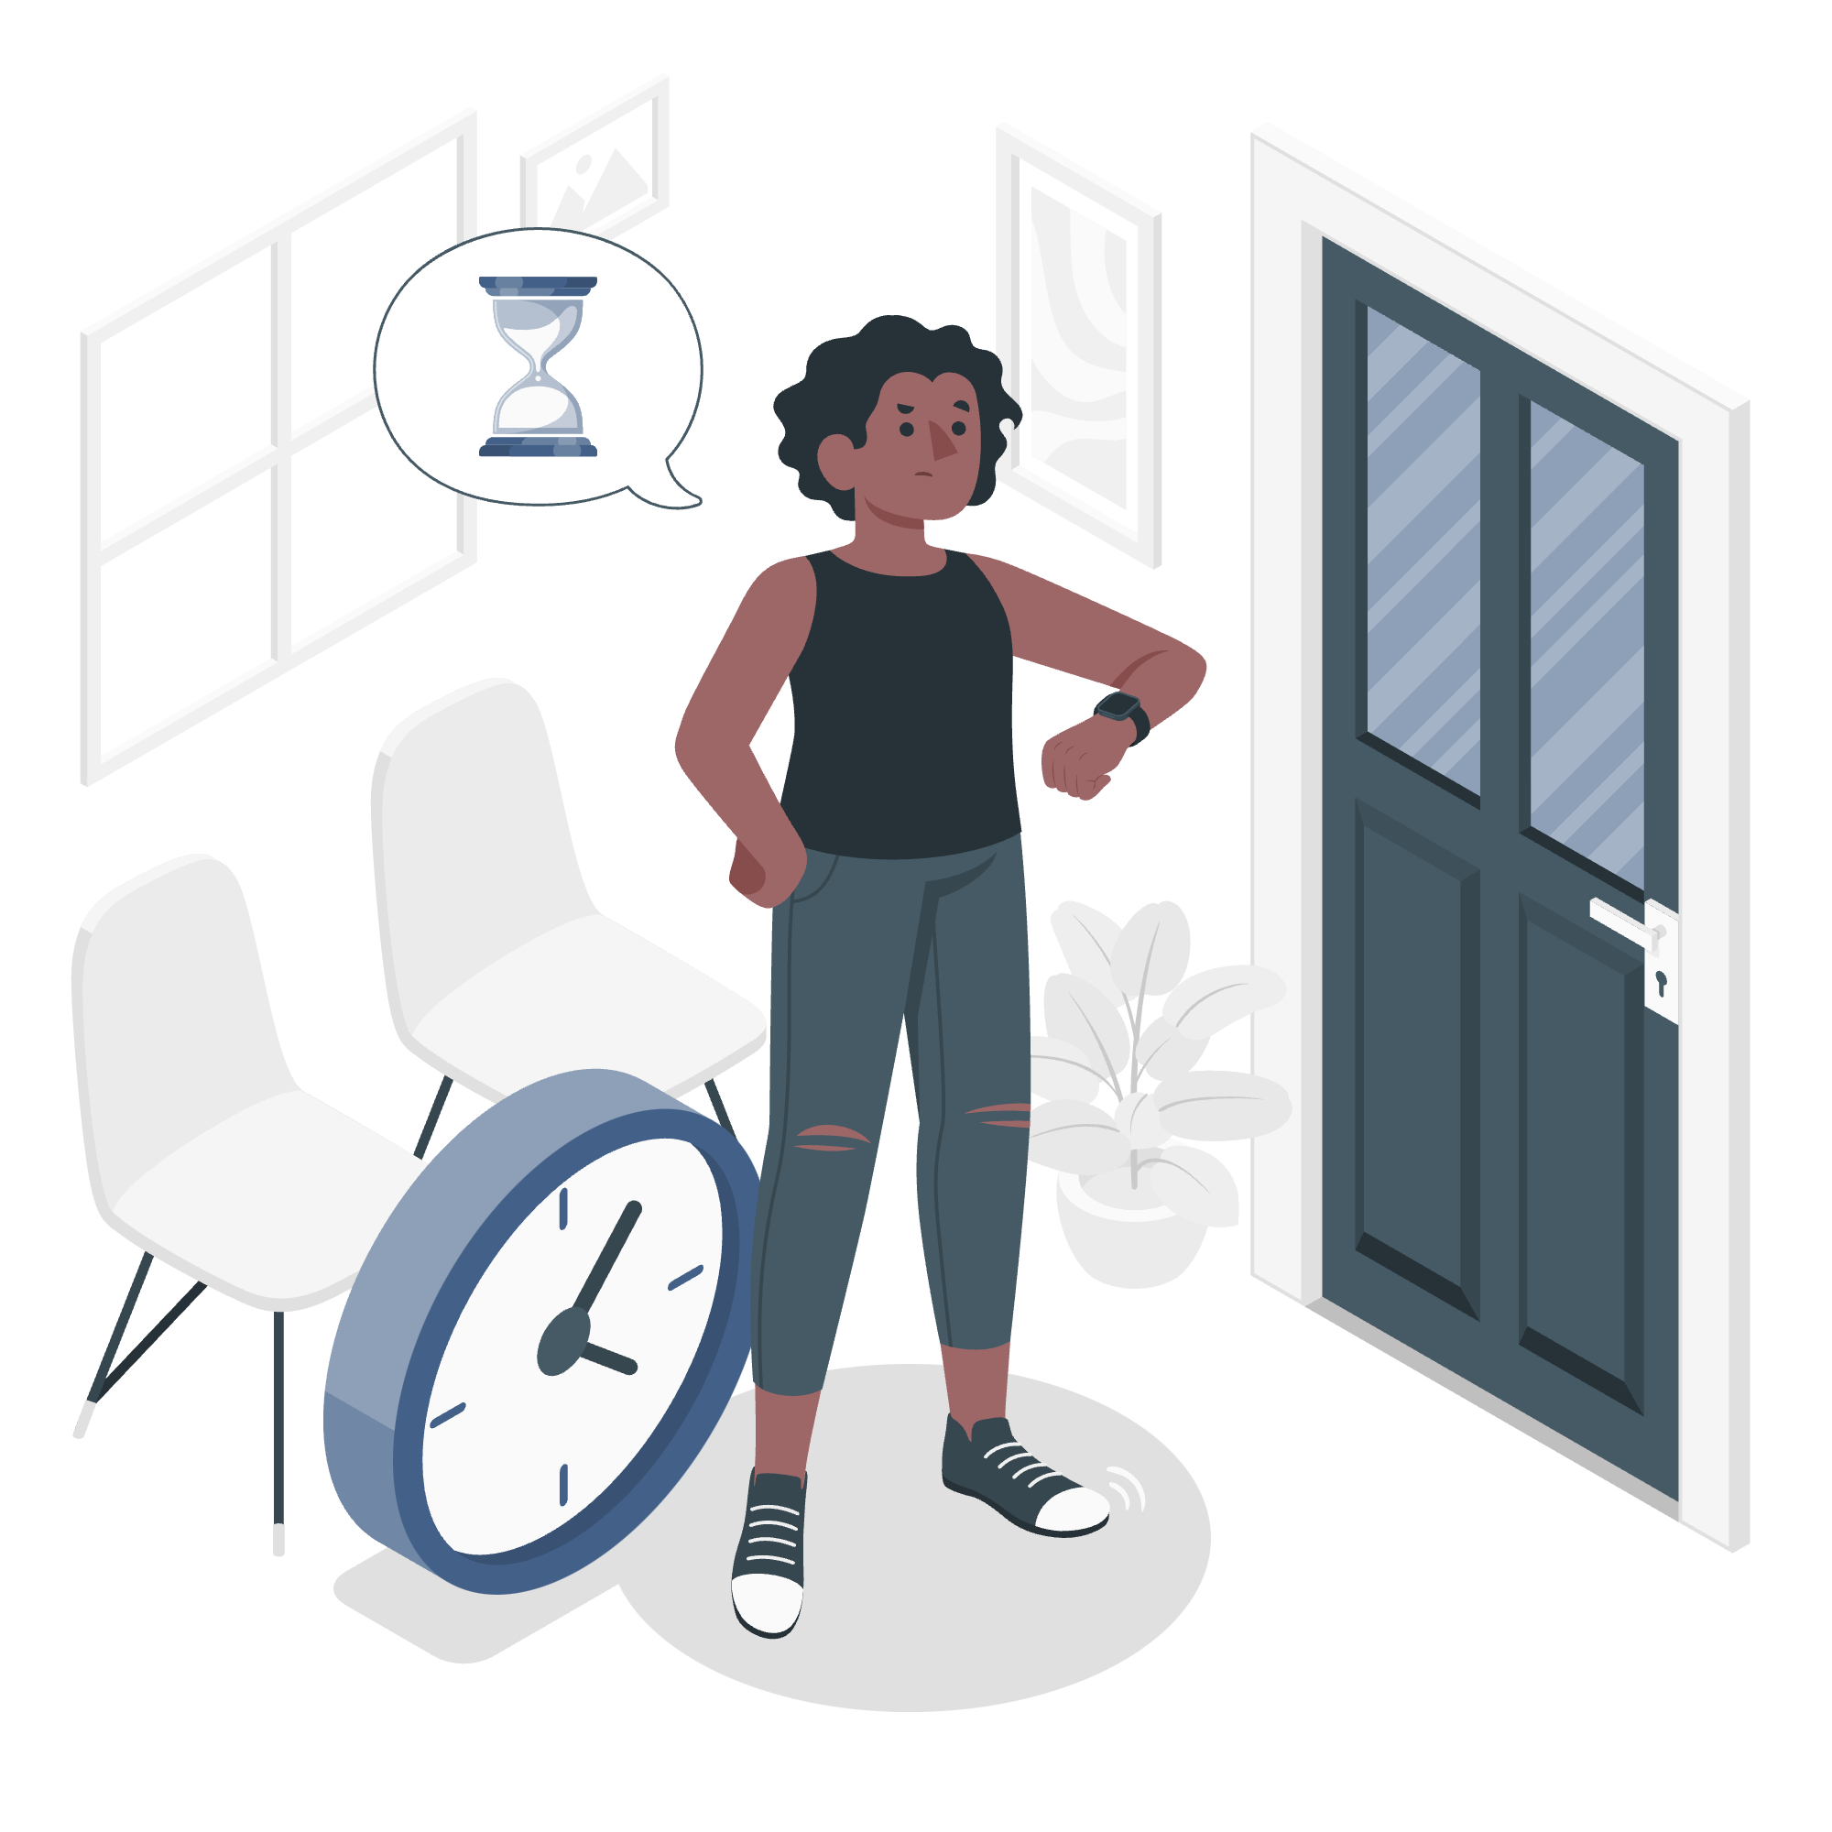




Problem
Independent auto repair shops do not have an efficient way of reaching and interacting with new customers
Customers do not have an efficient way to find and compare auto repair shops
Notes:
Joy
Imagine yourself as an auto repair shop owner. How do you find customers? - Well today, you likely rely on word-of-mouth referrals as a main channel for acquiring new customers
And how much time do you spend on managing appointments, providing quotes, and on other time-consuming administrative tasks?
- … (pause)... Probably more than you’d like, and I’m sure you’d rather be spending time fixing cars and making money. As an independent auto repair shop, It may be difficult to compete with larger repair shops who have dedicated systems and teams in place for managing all of this.
On the other hand, imagine yourself as a customer. How do you find auto repair shops or services?
- Currently, one of the only ways to compare repair shops is by manually searching, for example on Google, and reaching out to or visiting
repair shops one-by-one. You can probably imagine or know from experience that this process can be repetitive and time-consuming.

Slide 4
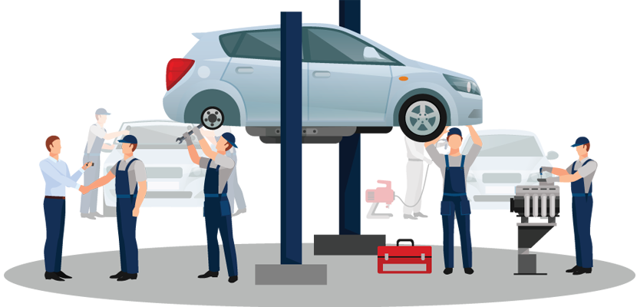
What is Sayyara?
Progressive web application (PWA)
A platform for vehicle owners and independent auto repair shops to connect & interact
Notes:
Joy
Sayyara provides a solution to all these problems. Sayyara is a Progressive Web Application which acts as an end-to-end platform for both vehicle owners and independent auto repair shops. Using Sayyara, vehicle owners and auto repair shops can more easily connect and interact throughout the entire auto repair process, and all in one place.

Slide 5



Customer Features
Find & filter shops
View shop profile
Live quotes
Create, view, and manage service requests
View work orders
Notes:
Leon
Sayyara offers a comprehensive set of features which makes it easy for vehicle owners to discover and find the right auto repair shop and service for them.
On the platform, customers can view shop profiles, where they can find relevant information such as hours of operation, contact information, and services offered by the shop
Customers can also request live quotes to get estimates and to share additional information with the shop
They can create, view, and manage service requests
And also keep up-to-date on the service status and additional details by viewing the work order

Slide 6




Permission-Based Shop Features
Feature | Shop Owner | Employee
Service Requests | View, Edit | View, Edit
Work Orders | View, Edit | View, Edit
Quotes | View, Edit | View, Edit
Services & Parts | View, Edit | View
Shop Profile | View, Edit | View
Employee Management | View, Edit | View
Notes:
Sayyara is an all-in-one platform which offers a set of permission-based shop features
This includes full permissions for the shop owner and limited permissions for employees to:
Manage service requests
Manage work orders
Interact with customers through the live quote system
Manage services & parts
Manage their shop profile
Manage shop employees

Slide 7
SFWRENG 4G06 | Final Presentation
Live Demo
Notes:
Tim Now we will do a live demo of the application

Slide 8

Incremental Design
Usability Survey
Project Supervisor Feedback
Real Feedback from Auto Repair Shops
TA and Instructor Feedback
Notes:
Arkin
Over the past 8 months, we have been building this app using the engineering design process we have learned throughout our program
We have been building this app using an iterative style, where we continuously go back and upgrade
Part of this, was going and getting feedback from our supervisor, real mechanics, and performing usability surveys
We would take this feedback, iterate based on the feedback, and repeat the process
For example, a feature that requested was to have clickable links on a shop profile’s contact details
We also fixed minor bugs brought up during the feedback process

Slide 9











Technologies
Notes:
Arkin
We have used a lot of different technologies to build this app
To get technical for a moment, we used:
Next.js, a React framework, to build the website
Out location services are power by Bing Maps
Our source code is hosted on GitHub
Our website is deploy on Vercel’s platform
Our database is MySQL hosted on PlanetScale

Slide 10

CI & CD
Pipelining for:
Building Documents (LaTeX →PDF)
Unit & Integration Tests
Code Styling & Quality
Automatic Deployment:
Deployment to Vercel
Notes:
Arkin
Our development process made use of the Continuous Integration & Continuous Delivery or Deployment model
CICD is a way for us to work more efficiently and delivering updates to users as quickly as possible.
To assist us in this process, we have a number of pipelines and automations, …

Slide 11

SFWRENG 4G06 | Final Presentation
Available Today On
Desktop & Mobile
sayyara.vercel.app

Slide 12
SFWRENG 4G06 | Final Presentation
Thank You!

